Slide 1
Interactive Calculator Using Functions

Slide 2
Introduction:
Python is a high-level, general-purpose programming language known for its clear, English-like syntax and emphasis on code readability. Which makes it popular for beginners and experienced developers alike.
Interpreted Language- Python code is executed line by line at runtime.
Dynamically Typed- Programmers do not need to declare variable types explicitly; python determines them during runtime.

Slide 3
Project Goal:
Create a Calculator that can perform basic arithmetic operation
    Addition
    Subtraction
    Multiplication
    Division
Features
    Uses functions for operations
    Handles division by Zero
    Interactive loop until user chooses to exit

Slide 4
Why use Functions
Functions are a fundamental building block in Python used to organize code into smaller, manageable, and reusable blocks, which makes programs easier to read, test, and maintain.
Easier to debug and update
Example
def add(a,b):
return a+b
This function can be used anywhere in the program.

Slide 5
Program Flow
Start the calculator
Ask user for two numbers
Display menu of operations
User selects operation
Perform calculation using functions
Show result
Repeat until user chooses Exit.

Slide 6
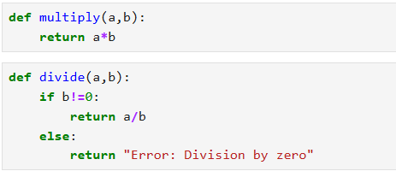
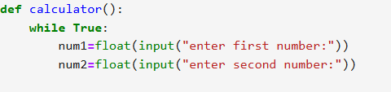
Code Snippet
This code demonstrates a function-based calculator with looping and basic error handling.

Slide 7
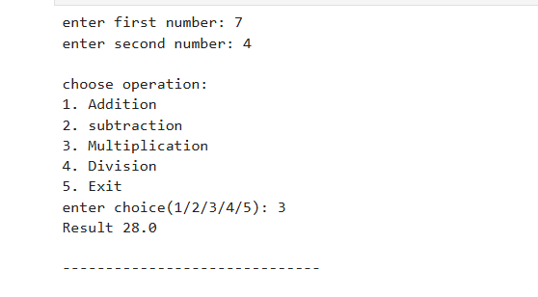
Sample output

Slide 8
Key Learning Points
Using functions for modular programming
Implementing while loops for repeated operations
Handling user input and errors
Writing clean, readable code.

Slide 9
Thank you!

